Slide 1
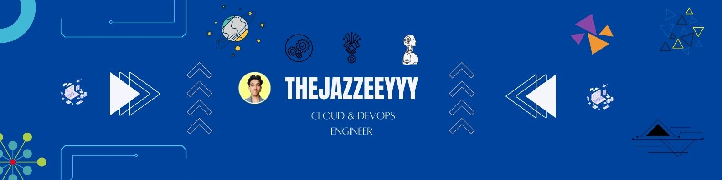
Operating Systems Basics

Slide 2
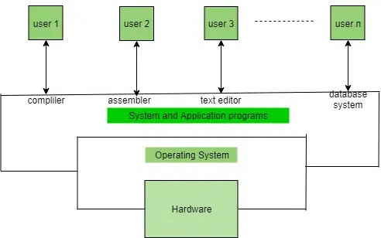
Operating systems are a software that is used to manage and handle the computer’s hardware and software resources.
It’s responsible for managing and controlling of all activities and sharing of computer resources to all running applications.
A low-level software that includes all basic funtions like process management, memory management, file management etc…
It’s a government for our system, and it has different departments to manage different resources.
Example’s are like Linux, Unix, Windows 11, Andriod, Ios, MacOs, etc…

Slide 3
Introduction of Operating Systems
It’s an interface b/w computer hardware and user.
It’s a software that provide an environment to the user for executing programs in conveniently and efficiently.
It’s a software that manages computer hardware and software, the hardware must provide appropriate mechanisms to ensure the correct operation of the computer system and to prevent user programs from interfering with the proper operation of the system.
It’s a program that runs all the time in our computer, with else being application programs.
Concerned with the assignments of resources among programs e.g, memory, processors and input/output devices.

Slide 4
Types of Operating Systems

Slide 5
1.Batch Operating System
This OS is not directly interact with computers.
This is an operator that takes similar jobs having the same requirements and groups them into batches.
It is the responsibility of the operator that sort jobs with the similar needs.
This type of OS is used to manage and execute a large number of jobs efficiently by processing them in groups.
Advantages:-
Multiple users can share the batch systems.
Idle time of the batch systems are very less.
It is easy to manage large amount of works repeatedly in batch systems

Slide 6
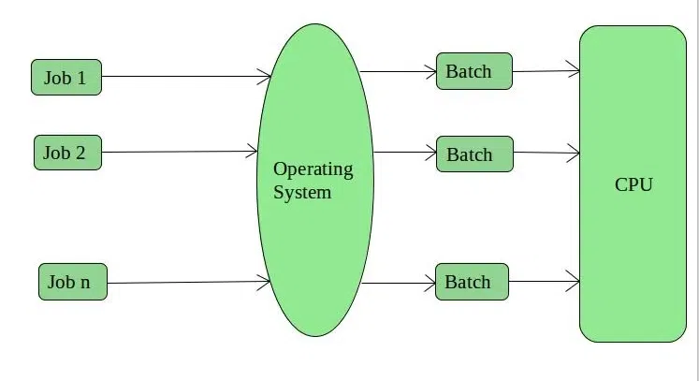
Disadvantages:-
CPU is not used efficiently, if the current job is used IO then CPU is free and could be utilized by other processes waiting.
The other job want to wait an unknown time if any job fails.
In Batch OS, The average response time increases as all processes are processed one by one.
Examples:- Payroll Systems, Bank statements, etc ..

Slide 7
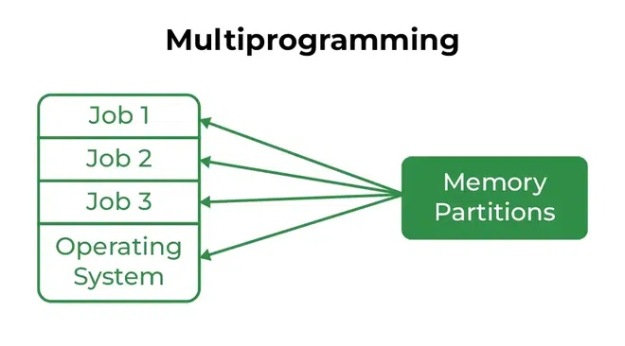
2. Multi-Programming OS
Multi-Programming OS is illustrated as more than one program is present in main memory and at a time a program can kept in execution. this is basically used for better utilization of resources.

Slide 8
Advantages:-
CPU is more utilized and overall performance of system is increased.
Reduced average response time.
Multi-Tasking/Time-Sharing OS
It is the type of multiprogramming system with every process running in round robin manner.
Each task is given sometime to execute so all the tasks works smoothly.
Each user gets the time of CPU as they use a single system.
These systems also known as multi-tasking systems.
The tasks can be from a single user or different user.
The time of each tasks gets to execute is called quantum.
After this time interval over OS switches to next task.

Slide 9
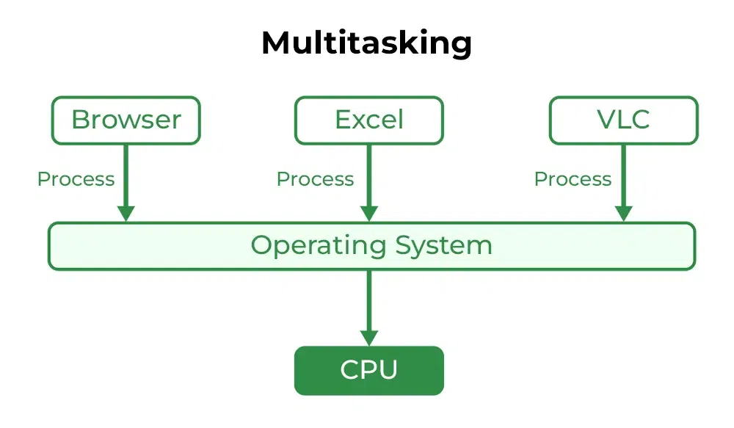
Advantages of Time-sharing OS:-
Each tasks getting equal opportunity.
Fewer chances of duplication of software.
Idle time can be reduced.
Resource sharing.
Improved Productivity.
Improved User Experience.

Slide 10
Disadvantages of Time-sharing OS:-
Reliability Problem.
One must have to take care of security and integrity of the data.
Data communication Problem.
High overhead.
Complexity.
Security Risks.
Examples:-
IBM VM/CMS.
Time-sharing option (TSO).
Windows Terminal services.

Slide 11
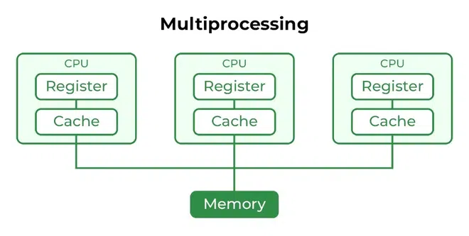
3. Multi-Processing OS
It is a type of operating system that uses more than one CPU is used for the execution of the resources, it is better the throughput of the system.
Advantages:-
It increases the throughput of the system as processes can be parallelized.
As it has several processes, so if one processes is fail we can use another processes.

Slide 12
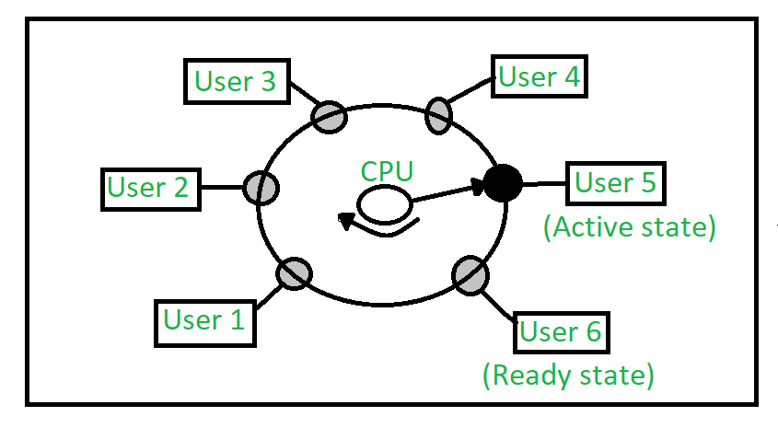
4. Multi-User OS
These OS allows multiple users to be active at the same time.
These Systems may be multiprocessor or single processor with interleaving.

Slide 13
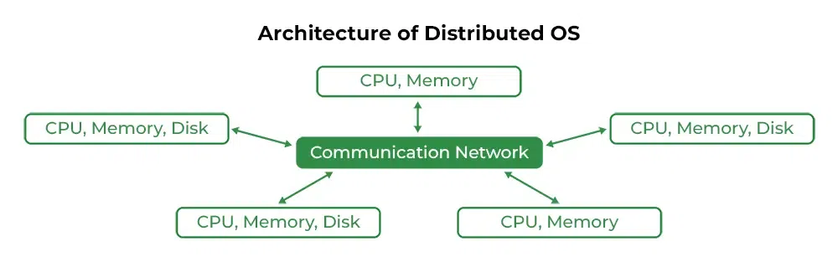
5. Distributed OS
Various autonomous interconnected computers are communicating through a shared communication network.
Independent systems possess their own memory units and CPU.
These system’s processors differ in size and functions.
The main benefit of these type of OS is one user can access the files or software from other system which is connected with this network even without having in his system.
Remote access is enabled within the devices in that network.

Slide 14
Advantages:-
Failure of one will not affect with other communication network, each systems are independent with each other.
Electronic mail increases the data exchange speed.
Since resources are being shared the computation is fast and durable.
Load on host computers reduces.
These systems are easily scalable as systems can be easily added to the network.
Delay in the Data processing reduces.
Disadvantages:-
Failure of main network will stop the entire communication.
To establish the distributed systems the language is used not well defined yet.
It is very expensive too.
Its underlying software is very complex and not understood yet.
Examples:- LOCUS, etc.

Slide 15
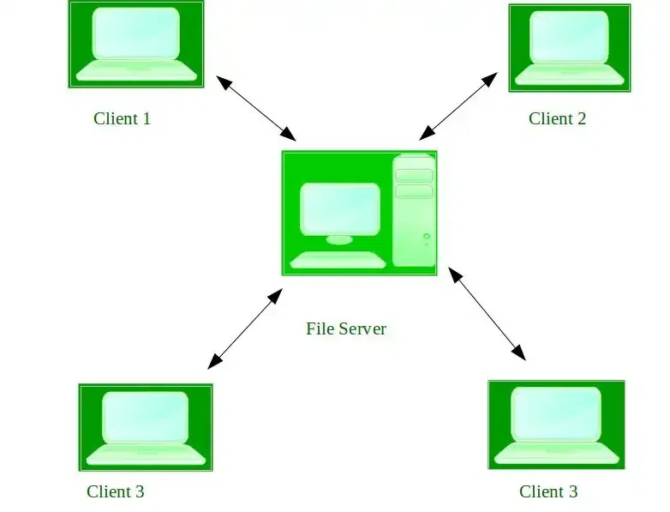
6. Network OS
These systems are run on server and provide the capability to manage data, security, users, groups, applications and other network functions.
It allow shared access to files, printers, security, applications and all other network functions over a small private network.
All users in the network is well aware of the underlying configurations, all of other users within the network, their individual connections, etc..
These computers also called tightly coupled systems.

Slide 16
Advantages:-
Highly stable centralized servers.
Security concerns are handled by servers.
New technologies and hardware upgradation are easily integrated into the systems.
Server access possibly in remotely from different locations and types of systems.
Disadvantages:-
Servers are costly.
Users are dependent on central locations for most operations.
Maintenance and updates are required regularly.

